Slide 1
Dockers & Containers
Author: Pritish Mishra

Slide 2
Containers vs. VMs
Containers share resources with the host OS, which makes them an order of magnitude more efficient. Containers can be started and stopped in a fraction of a second. Applications running in containers incur little to no overhead compared to applications running natively on the host OS.
The portability of containers has the potential to eliminate a whole class of bugs caused by subtle changes in the running environment—it could even put an end to the age-old developer refrain of “but it works on my machine!”
The lightweight nature of containers means developers can run dozens of containers at the same time, making it possible to emulate a production-ready distributed system. Operations engineers can run many more containers on a single host machine than using VMs alone.
Containers also have advantages for end users and developers outside of deploying to the cloud. Users can download and run complex applications without needing to spend hours on configuration and installation issues or worrying about the changes required to their system. In turn, the developers of such appli‐ cations can avoid worrying about differences in user environments and the avail‐ ability of dependencies.

Slide 3
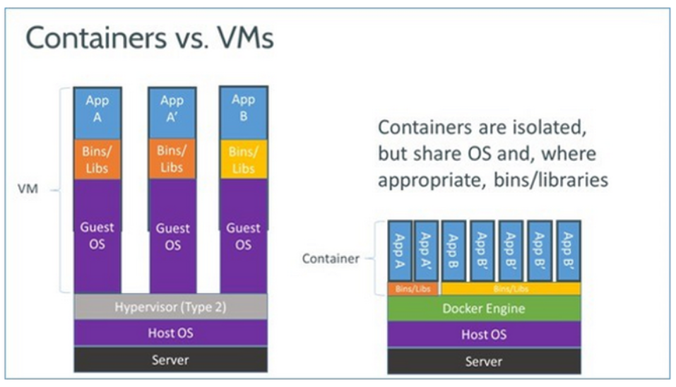
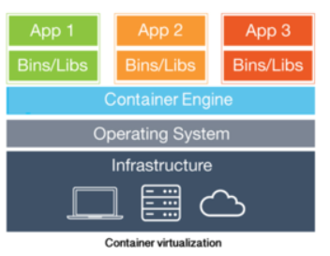
Containers/Dockers vs. VMs.

Slide 4
Linux cgroups vs. namespaces
cgroups and namespaces are the Linux kernel features that create the walls between containers and other processes running on the host.
Linux namespaces, originally developed by IBM, wrap a set of system resources and present them to a process to make it look like they are dedicated to that process.
Linux cgroups, originally developed by Google, govern the isolation and usage of system resources, such as CPU and memory, for a group of processes. For example, if you have an application that takes up a lot of CPU cycles and memory, such as a scientific computing application, you can put the application in a cgroup to limit its CPU and memory usage.
Namespaces deal with resource isolation for a single process, while cgroups manage resources for a group of processes.

Slide 5
LXC ( Linux Containers)
LXC is a Linux operating system-level virtualization method for running multiple isolated Linux systems on a single host.
Namespaces and cgroups features make LXC possible. (how?)
Containers decouple applications from operating systems, which means that users can have a clean and minimal Linux operating system and run everything else in one or more isolated container.
Also, because the operating system is abstracted away from containers, you can move a container across any Linux server that supports the container runtime environment.

Slide 6
Dockers vs Containers
What docker brings new to the table?

Slide 7
Single vs. multiprocess
Docker restricts containers to run as a single process. If your application environment consists of X concurrent processes, Docker wants you to run X containers, each with a distinct process.
By contrast, LXC containers have a conventional init process and can run multiple processes.
To run a simple multitier Web application in Docker, you would need a PHP container, an Nginx container (the Web server), a MySQL container (for the database process), and a few data containers for the database storage and other application data.
Adv: easy and more granular updates. Why shut down the database process when all you wanted to update is the Web server?
Also, single-process containers represent an efficient architecture for building microservices-based applications.
Limitations: can’t run agents, logging scripts, or an SSH daemon inside the container.
It’s not easy to commit small, application-level changes to a single-process container. You are essentially forced to start a new, updated container.

Slide 8
Stateless vs. stateful
Docker containers are designed to be stateless, more so than LXC.
First, Docker does not support persistent storage.
DOCKER VOLUME: Docker gets around this by allowing you to mount host storage as a “Docker volume” from your containers. Because the volumes are mounted, they are not really part of the container environment.
Second, Docker containers consist of read-only layers.
READ-ONLY: This means that, once the container image has been created, it does not change. During runtime, if the process in a container makes changes to its internal state, a “diff” is made between the internal state and the image from which the container was created.
If you run the docker commit command, the diff becomes part of a new image -- not the original image, but a new image, from which you can create new containers. Otherwise, if you delete the container, the diff disappears.
Adv: A stateless container is an interesting entity. You can make updates to a container, but a series of updates will engender a series of new container images, so system rollbacks are easy.

Slide 9
Portability
This is perhaps the single most important advance of Docker over LXC.
Docker abstracts away more networking, storage, and OS details from the application than LXC does.
With Docker, the application is truly independent from the configurations of these low-level resources.
When you move a Docker container from one Docker host to another Docker-enabled machine, Docker guarantees that the environment for the application will remain the same.
By this approach, Docker enables developers to set up local development environments that are exactly like a production server. When a developer finishes writing and testing his code, he can wrap it in a container and publish it directly to an AWS server or to his private cloud, and it will instantly work because the environment is the same.
Even with LXC, a developer can get something running on his own machine, but discover that it doesn’t run properly when he deploys to the server; the server environment will be different, requiring the developer to spend an enormous amount of time debugging the difference and fixing the issue.
Docker took away that complexity. This is what makes Docker containers so portable and easy to use across different cloud and virtualization environments.

Slide 10
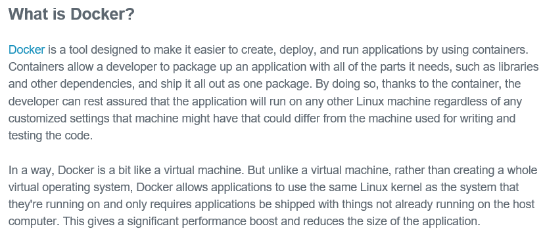
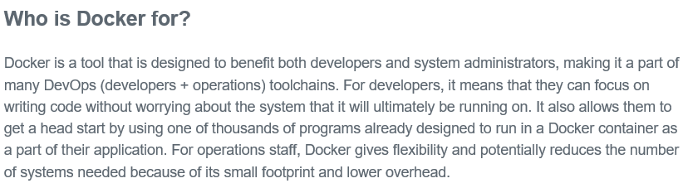

Slide 11
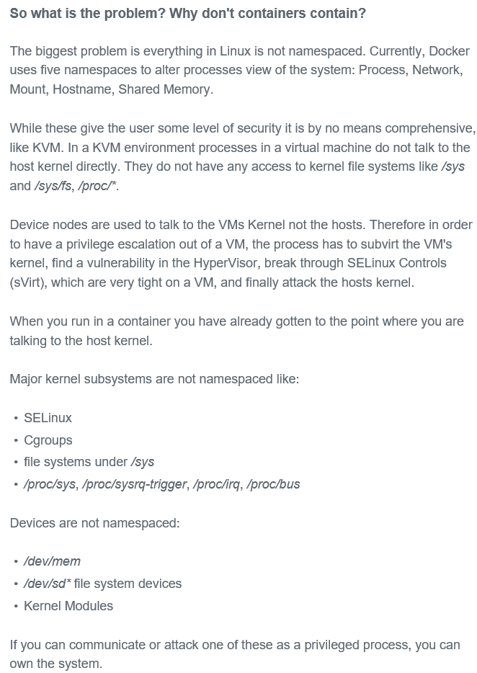
Security concerns in containers

Slide 12
Using Docker
Adrian Mouat

Slide 13
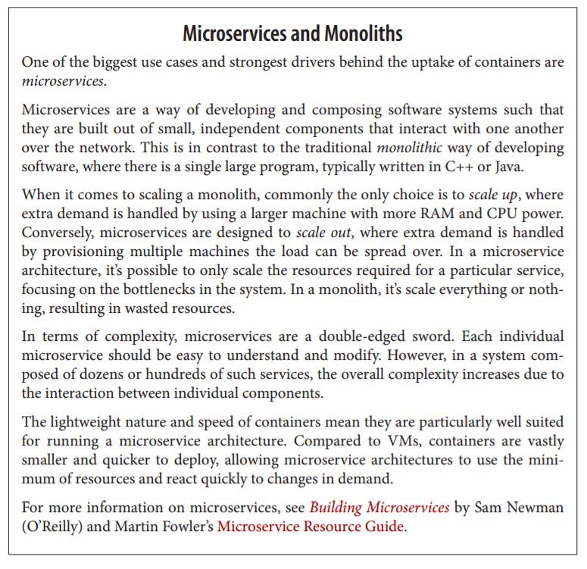

Slide 14
Installation

Slide 15
For Linux:
curl -sSL https://get.docker.com/ | sh
Or
wget -qO- https://get.docker.com/ | sh

Slide 16
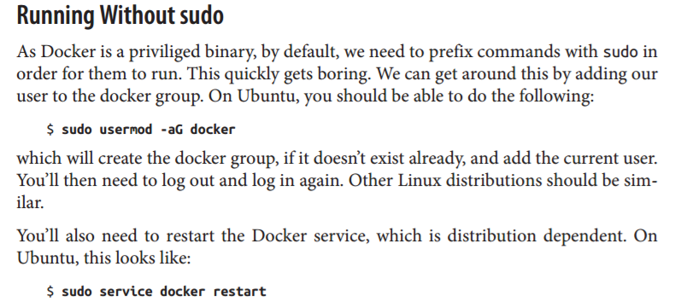

Slide 17
For Mac OS/Windows:
If you are using Windows or Mac OS, you will need some form of virtualization in order to run Docker.
Choice 1: You can download a full VM solution and follow the Linux instructions to install Docker.
Choice 2: Install the Docker Toolbox, which includes the minimal boot2docker VM as well as other Docker tools such as Compose and Swarm. (Recommended)
Once the Toolbox is installed, you can access Docker by opening the Docker quick‐ start terminal.

Slide 18
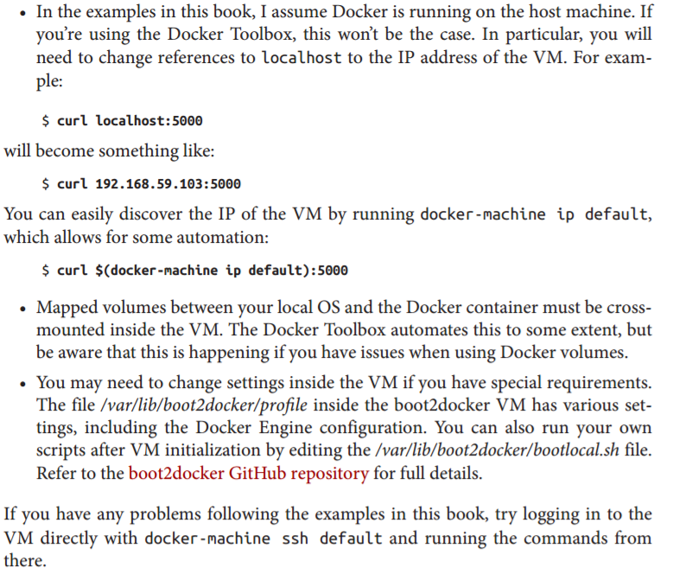
Beware of following while running Docker Toolbox

Slide 19
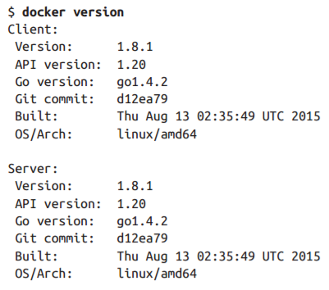
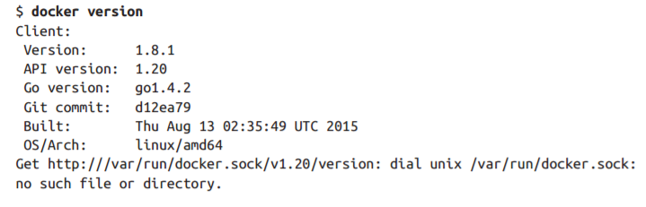
A Quick Check
Correct
Incorrect

Slide 20
First Steps

Slide 21
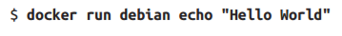
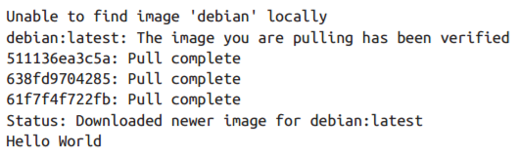
Running your first image

Slide 22
What happened?
We’ve called the docker run command, which is responsible for launching containers. The argument debian is the name of the image we want to use—in this case, a stripped-down version of the Debian Linux distribution. The first line of the output tells us we don’t have a local copy of the Debian image. Docker then checks online at the Docker Hub and downloads the newest version of the Debian image. Once the image has been downloaded, Docker turns the image into a running container and executes the command we specified—echo "Hello World"— inside it. The result of running this command is shown in the last line of the output.

Slide 23
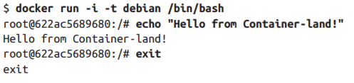
Invoking command prompt
This will give you a new command prompt inside the container, very similar to ssh’ing into a remote machine. In this case, the flags -i and -t tell Docker we want an interactive session with a tty attached. The command /bin/bash gives us a bash shell. When you exit the shell, the container will stop—containers only run as long as their main process.

Slide 24
Basic Commands

Slide 25
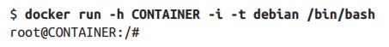
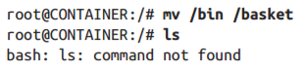
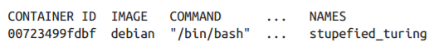
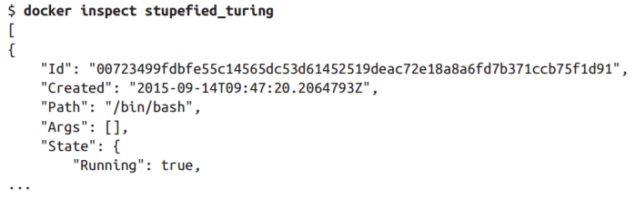
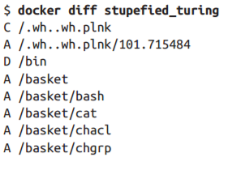
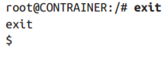
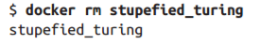
First, let’s launch a new container; but this time, we’ll give it a new hostname with the -h flag:
Let’s break the container:
Running “docker ps”:
Inspect & Diff:
Exiting:
Removing a container:

Slide 26
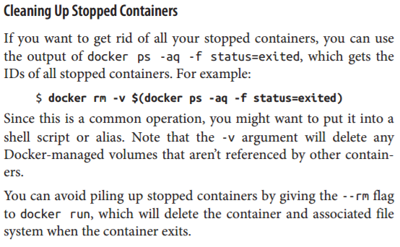

Slide 27
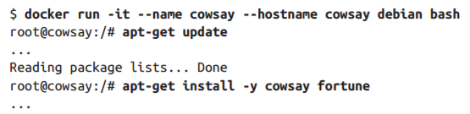
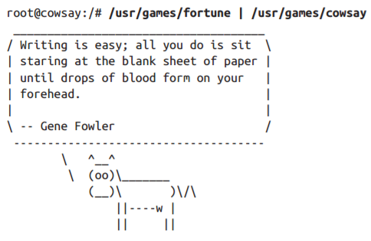
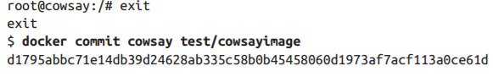
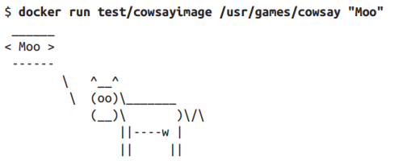
Creating another docker container and running “cowsay” application in it:
To turn it into an image, we can just use the docker commit command. It doesn’t matter if the container is running or stopped. To do this, we need to give the command the name of the container (“cowsay”) a name for the image (“cowsayimage”) and the name of the repository to store it in (“test”):
Now we have an image with cow‐ say installed that we can run:

Slide 28
Building Images from Dockerfiles

Slide 29
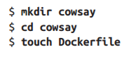
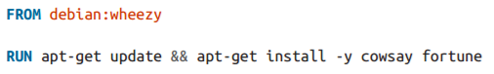
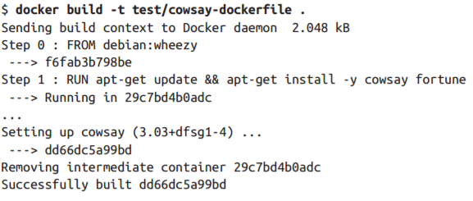
A Dockerfile is simply a text file that contains a set of steps that can be used to create a Docker image.
Insert the following in Dockerfile:
The FROM instruction specifies the base image to use (debian, as before; but this time, we have specified that we want to use the version tagged “wheezy”). All Dockerfiles must have a FROM instruction as the first noncomment instruction. RUN instructions specify a shell command to execute inside the image. In this case, we are just installing cowsay and fortune in the same way as we did before.
Build the image:→→→→→→→→→→→
Run the image:

Slide 30
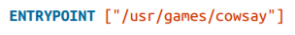
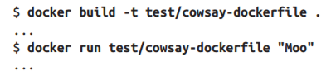
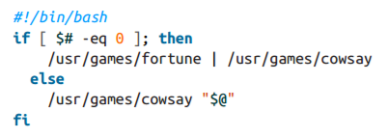
Introducing ENTRYPOINT
The ENTRYPOINT instruction lets us specify an executable that is used to handle any arguments passed to docker run.
Add the following to the Dockerfile:
Rebuild & run:
To be able to get the generic o/p and specific o/p from cowsay application:
Create a file entrypoint.sh with the following contents and save it in the same directory as the Dockerfile.
Set the file to be executable with chmod +x entrypoint.sh.

Slide 31
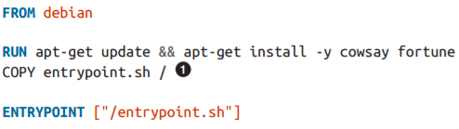
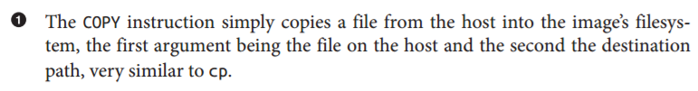
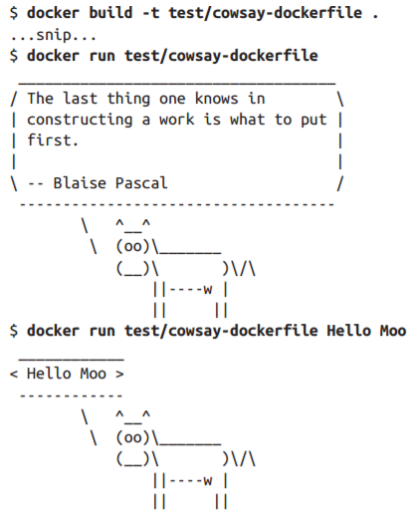
We next need to modify the Dockerfile to add the script into the image and call it with the ENTRYPOINT instruction. Edit the Dockerfile so that it looks like:
Testing it out with and without arguments:

Slide 32
Working with registeries

Slide 33
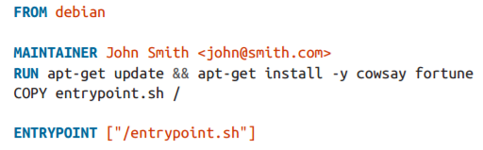
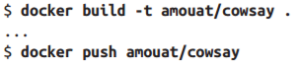
In order to upload our cowsay image, you will need to sign up for an account with the Docker Hub (either online or using the docker login command). After you have done this, all we need to do is tag the image into an appropriately named repository and use the docker push command to upload it to the Docker Hub.
First, let’s add a MAINTAINER instruction to the Dockerfile, which simply sets the author contact information for the image:
Now let’s rebuild the image and upload it to the Docker Hub.
You will need to use a repository name that starts with your username on the Docker Hub (in this case, amouat), followed by / and whatever name you want to give the image. For example:
As we didn’t specify a tag after the repository name, it was automatically assigned the latest tag. To specify a tag, just add it after the repository name with a colon (e.g., docker build -t amouat/cowsay:stable .)
Once the upload has completed, the world can download your image via the docker pull command (e.g., docker pull amouat/cowsay).

Slide 34
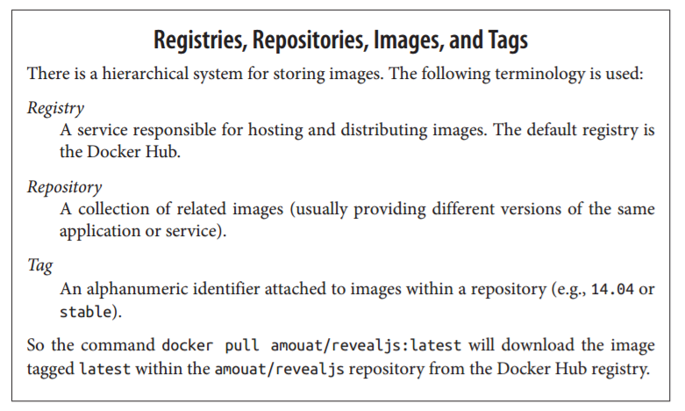

Slide 35
Image Namespaces
Names prefixed with a string and /, such as amouat/revealjs, belong to the “user” namespace. These are images on the Docker Hub that have been uploaded by a given user. For example, amouat/revealjs is the revealjs image uploaded by the user amouat.
Names such as debian and ubuntu, with no prefixes or /s, belong to “root” name‐ space, which is controlled by Docker Inc. and reserved for the official images for common software and distributions available from the Docker Hub. There are official images for most common software packages, which should be your first port of call when looking for an image to use.
Names prefixed with a hostname or IP are images hosted on third-party regis‐ tries (not the Docker Hub). These include self-hosted registries for organizations, as well as competitors to the Hub, such as quay.io. For example, localhost: 5000/wordpress refers to an WordPress image hosted on a local registry.

Slide 36
Using the official Redis image

Slide 37
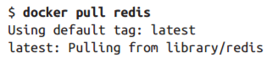
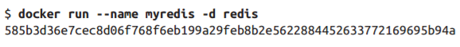
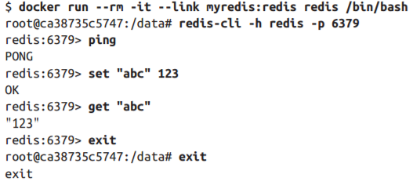
Start by getting the image:
Start up the Redis container, but this time use the -d argument:
The -d tells Docker to run the container in the background. Docker starts the con‐ tainer as normal, but rather than printing the output from the container, it returns the containers ID and exits. The container is still running in the background, and you can use the docker logs command to see any output from the container.
Linking two containers:
We launched a new container to run redis-cli in it and linked the two containers.

Slide 38
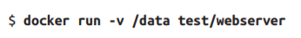
Persistence (Backing Up) of data
Docker provides this through the concept of volumes.
Volumes are files or directories that are directly mounted on the host and not part of the normal union file system. This means they can be shared with other containers and all changes will be made directly to the host filesystem.
There are two ways of declaring a directory as a volume:
Using the VOLUME instruction inside a Dockerfile:
Specifying the -v flag to docker run.
Both the following Dockerfile instruction and docker run command have the effect of creating a volume as /data inside a container.
By default, the directory or file will be mounted on the host inside your Docker installation directory (normally /var/lib/docker/).

Slide 39
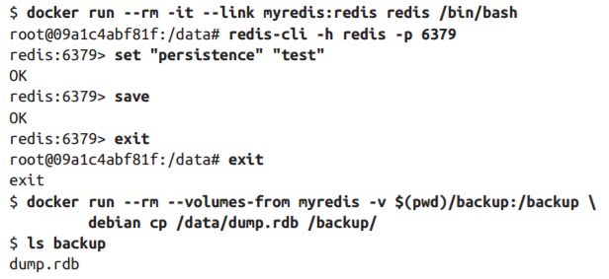
It is possible to specify the host directory to use as the mount via the docker run command (e.g., docker run -d - v /host/dir:/container/dir test/webserver).
Applying this on the Redis container that we had created:
We use the –v argument to mount a known directory and --volumes-from argument to load the volumes from another container. (in this example, myredis)

Slide 40
Docker Architecture

Slide 41
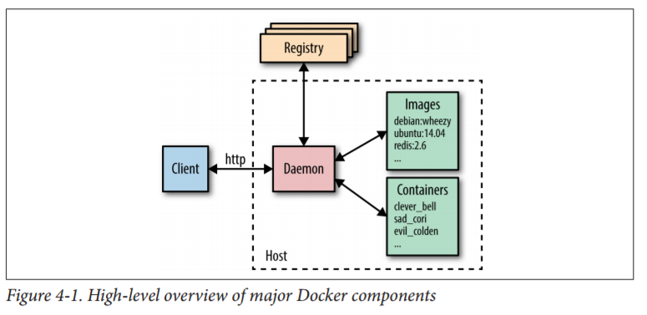

Slide 42
At the center is the Docker daemon, which is responsible for creating, running, and monitoring containers, as well as building and storing images, both of which are represented on the right of the diagram. The Docker daemon is launched by running docker daemon, which is normally taken care of by the host OS.
The Docker client is on the left-hand side and is used to talk to the Docker daemon via HTTP. By default, this happens over a Unix domain socket, but it can also use a TCP socket to enable remote clients or a file descriptor for systemdmanaged sockets.
Since all communication has to be done over HTTP, it is easy to connect to remote Docker daemons and develop programming language bind‐ ings.
But it also has implications for how features are implemented, such as requiring a build context for Dockerfiles.
The API used for communication with daemon is well defined and documented, allowing developers to write programs that interface directly with the deamon, without using the Docker client.
The Docker client and daemon are distributed as a single binary.
Docker registries store and distribute images. The default registry is the Docker Hub, which hosts thousands of public images as well as curated “official” images.

Slide 43
Underlying technologies
The Docker daemon uses an “execution driver” to create containers. By default, this is Docker’s own runc driver.
Runc is very closely tied to the following kernel features:
cgroups: which are responsible for managing resources used by a container (e.g., CPU and memory usage). They are also responsible for freezing and unfreezing containers, as used in the docker pause functionality.
namespaces: are responsible for isolating containers; making sure that a container’s filesystem, hostname, users, networking, and processes are separated from the rest of the system.

Slide 44
Surrounding technologies
Swarm: Docker’s clustering solution. Swarm can group together several Docker hosts, allowing the user to treat them as a unified resource.
Compose: Docker Compose is a tool for building and running applications composed of multiple Docker containers. It is primarily used in development and testing rather than production.
Machine: Docker Machine installs and configures Docker hosts on local or remote resour‐ ces. Machine also configures the Docker client, making it easy to swap between environments.
Kitematic: Kitematic is a Mac OS and Windows GUI for running and managing Docker containers.

Slide 45
3rd party applications built on Docker
Networking:
Creating networks of containers that span hosts is a nontrivial problem that can be solved in a variety of ways. Several solutions have appeared in this area, including Weave and Project Calico. In addition, Docker will soon have an integrated networking solution called Overlay. Users will be able to swap out the Overlay driver for other solutions using Docker’s networking plugin framework.
Service Discovery:
When a Docker container comes up, it needs some way of finding the other serv‐ ices it needs to talk to, which are typically also running in containers. As contain‐ ers are dynamically assigned IP addresses, this isn’t a trivial problem in a large system. Solutions in this area include Consul, Registrator, SkyDNS, and etcd.
Orchestration and cluster management:
In large container deployments, tooling is essential in order to monitor and man‐ age the system. Each new container needs to be placed on a host, monitored, and updated. The system needs to respond to failures or changes in load by moving, starting, or stopping containers appropriately. There are already several compet‐ ing solutions in the area, including Kubernetes from Google, Marathon (a frame‐ work for Mesos), CoreOS’s Fleet, and Docker’s own Swarm tooling.

Slide 46
How are images built
The primary way to make new images is through dockerfiles and the docker build command. This section will look at what happens here in a little more depth and end with a guide to the various instructions that can be used in a dockerfile.

Slide 47
The build context
The docker build command requires a Dockerfile and a build context (which can even be empty).
The build context is the set of local files and directories that can be refer‐ enced from ADD or COPY instructions in the Dockerfile and is normally specified as a path to a directory.
E.g. the build command ‘docker build -t test/cowsay-dockerfile .’ which sets the context to '.', the current working directory. All the files and directories under the path form the build context and will be sent to the Docker daemon as part of the build process.
In cases where a context is not specified-if only a URL to a Dockerfile is given or the contents of a Dockerfile is piped from STDIN--the build context is considered to be empty.
A git repository can also be given as the build context. In this situation, the Docker client will clone the repository and any submodules to a temporary directory that is then sent to the Docker daemon as the build context. Docker will interpret the con‐ text as a git repository if the path begins with github.com/, _ git@, or _git://. (Not advisable)

Slide 48
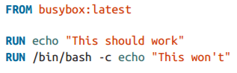
Image Layers
Each instruction in a Dockerfile results in a new image layer, which can also be used to start a container.
The new layer is created by starting a container using the image of the previous layer, executing the Dockerfile instruction and saving a new image.
When a Dockerfile instruction successfully completes, the intermediate container will be deleted, unless the --rm=false argument was given.
When a build fails, it can be very useful to launch the layer before the failure.
For example, if we have the following Dockerfile:

Slide 49
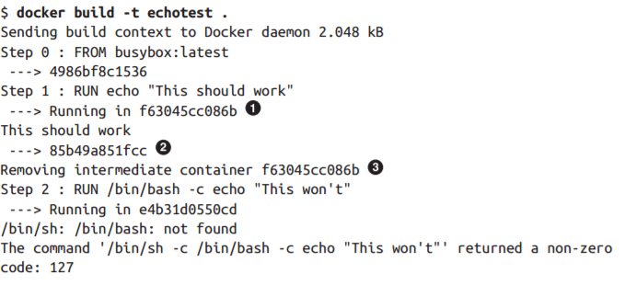
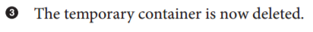
And build it:
While, in this case, the problem is fairly clear from the error, we can run the image created from the last successful layer in order to debug the instruction. Note that we are using the last image ID here (85b49a851fcc), not the ID of the last container (e4b31d0550cd).

Slide 50
Dockerfile Instructions
This section briefly covers the various instructions available for use in dockerfiles.

Slide 51
ADD
Copies files from the build context or remote URLs into the image. If an archive file is added from a local path, it will automatically be unpacked.
As the range of functionality covered by ADD is quite large, it’s generally best to prefer the simpler COPY command for copying files and directories in the build context and RUN instructions with curl or wget to download remote resources (which retains the possibility of processing and deleting the download in the same instruction).

Slide 52
CMD
Runs the given instruction when the container is started. If an ENTRYPOINT has been defined, the instruction will be interpreted as an argument to the ENTRY POINT (in this case, make sure you use the exec format). The CMD instruction is overridden by any arguments to docker run after the image name. Only the last CMD instruction will have an effect, and any previous CMD instructions will be overridden (including those in base images).

Slide 53
COPY
Used to copy files from the build context into the image. It has two forms, COPY src dest_ and COPY ["src", "dest"], both of which copy the file or directory at src in the build context to dest inside the container. Note that you cannot specify src paths outside the build context (e.g., ../another_dir/myfile will not work).
ENTRYPOINT
Sets an executable (and default arguments) to be run when the container starts. Any CMD instructions or arguments to docker run after the image name will be passed as parameters to the executable. ENTRYPOINT instructions are often used to provide “starter” scripts that initialize variables and services before interpreting any given arguments.

Slide 54
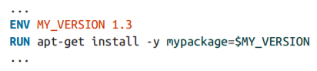
ENV
Sets environment variables inside the image. These can be referred to in subsequent instructions. For example:
The variables will also be available inside the image.
EXPOSE
Indicates to Docker that the container will have a process listening on the given port or ports. This information is used by Docker when linking containers or publishing ports by supplying the -P argument to docker run; by itself the EXPOSE instruction will not affect networking.

Slide 55
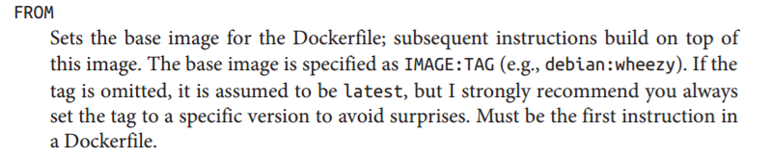
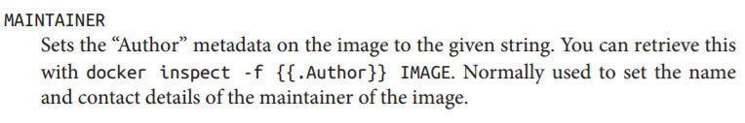
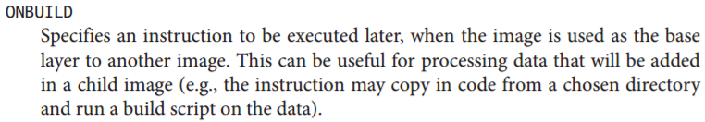


Slide 56



Slide 57
Connecting Containers to the world

Slide 58


Say you’re running a web server inside a container.
How do you provide the outside world with access? The answer is to “publish” ports with the -p or -P commands.
This command forwards ports on the host to the container.
The -p 8000:80 argument has told Docker to forward port 8000 on the host to port 80 in the container.
Alternatively, the -P argument can be used to tell Docker to automatically select a free port to forward to on the host.
The primary advantage of the -P command is that you are no longer responsible for keeping track of allocated ports, which becomes important if you have several containers publishing ports. In these cases you can use the docker port command to discover the port allocated by Docker.

Slide 59
Linking containers

Slide 60

Docker links are the simplest way to allow containers on the same host to talk to each other.
Links are initialized by giving the argument --link CONTAINER:ALIAS to docker run, where CONTAINER is the name of the linked container and ALIAS is a local name used inside the master container to refer to the linked container.
Using Docker links will also add the alias and the link container ID to /etc/hosts on the master container, allowing the link container to be addressed by name from the master container.
In addition, Docker will set a bunch of environment variables inside the master container that are designed to make it easy to talk to the link container.
For example, if we create and link to a Redis container:

Slide 61
Managing Data with Volumes and Data Containers

Slide 62


Method 1
We can declare a volume at runtime with the -v flag.
This will make the directory /data inside the container into a volume. Any files the image held inside the /data directory will be copied into the volume. We can find out where the volume lives on the host by running docker inspect on the host from a new shell:
In this case, the volume /data/ in the container is simply a link to the directory /var/lib/docker/volumes/5cad…/_data on the host. To prove this, we can add a file into the directory on the host:
And you should immediately be able to see from inside the container:

Slide 63



Method 2
The second way to set up a volume is by using the VOLUME instruction in a Dockerfile:
This has exactly the same effect as specifying -v /data to docker run.

Slide 64
Method 3 (Bind Mounting)
Extend the -v argument to docker run with an explicit directory to bind to on the host using the format -v HOST_DIR:CONTAINER_DIR. This can’t be done from a Dockerfile (it would be non-portable and a security risk). For example:
This will mount the directory /home/adrian/data on the host as /data inside the con‐ tainer. Any files already existing in the /home/adrian/data directory will be available inside the container. If the /data directory already exists in the container, its contents will be hidden by the volume. Unlike the other invocations, no files from the image will be copied into the volume, and the volume won’t be deleted by Docker (i.e., docker rm -v will not remove a volume that is mounted at a user-chosen directory).

Slide 65

Sharing data:
The -v HOST_DIR:CONTAINER_DIR syntax is very useful for sharing files between the host and one or more containers. For example, configuration files can be kept on the host and mounted into containers built from generic images.
We can also share data between containers by using the --volumes-from CONTAINER argument with docker run. For example, we can create a new container that has access to the volumes from the container in our previous example like so:
It’s important to note that this works whether or not the container holding the volumes (container-test in this case) is currently running. As long as at least one exist‐ ing container links to a volume, it won’t be deleted.

Slide 66
Data containers:
A common practice is to create data containers—containers whose sole purpose is to share data between other containers.
The main benefit of this approach is that it provides a handy namespace for volumes that can be easily loaded using the --volumesfrom command.
For example, we can create a data container for a PostgreSQL database with the following command:
This will create a container from the postgres image and initialize any volumes defined in the image before running the echo command and exiting. There’s no need to leave data containers running, since doing so would just be a waste of resources.
We can then use this volume from other containers with the --volumes-from argument. For example:

Slide 67
Deleting volumes:
Volumes are only deleted if:
• the container was deleted with docker rm -v, or
• the --rm flag was provided to docker run
And
• no existing container links to the volume
• no host directory was specified for the volume (the –v HOST_DIR:CONTAINER_DIR syntax was not used)

Slide 68
COMMON DOCKER COMMANDS

Slide 69
The run command

Slide 70




Basic modes of operation:

Slide 71




Setting of container names and variables:

Slide 72
Managing volumes:
-v, --volume
There are two forms of the argument to set up a volume.
The first form only specifies the directory within the container and will bind to any host directory chosen by the Docker.
The second form specifies the host directory to bind to.
--volumes-from
Mounts volumes from the specified container. Often used in association with data containers.

Slide 73
Networking options:
--expose
Equivalent of Dockerfile EXPOSE instruction. Identifies the port or port range as being used in the container but does not open the port. Only really makes sense in association with -P and when linking containers.
--link
Sets up a private network interface to the specified container.
-p, --publish
“Publishes” a port on the container, making it accessible from the host. If the host port is not defined, a random high-numbered port will chosen, which can be discovered by using the docker port command. The host interface on which to expose the port may also be specified.
-P, --publish-all
Publish all exposed ports on the container to the host. A random high-numbered port will be chosen for each exposed port. The docker port command can be used to see the mapping.

Slide 74



Overriding Dockerfile settings:

Slide 75
Managing Containers

Slide 76





Slide 77




Slide 78





Slide 79
Docker Info

Slide 80




Slide 81
Container Info

Slide 82




Slide 83




Slide 84
Dealing with images

Slide 85

docker build
Builds an image from a Dockerfile.
docker commit
Creates an image from the specified container.
For example:
docker export
Exports the contents of the container’s filesystem as a tar archive on STDOUT. The resulting archive can be loaded with docker import.
docker history
Outputs information on each of the layers in an image.
docker images
Provides a list of local images, including information such as repository name, tag name, and size

Slide 86

docker import
Creates an image from an archive file containing a filesystem, such as that created by docker export.
Example of “flattening” an image by exporting and importing:
docker load
Loads a repository from a tar archive passed via STDIN
docker rmi
Deletes the given image or images
docker save
Saves the named images or repositories to a tar archive, which is streamed to STDOUT (use -o to write to a file).
docker tag
Associates a repository and tag name with an image.

Slide 87
Using the registry

Slide 88
docker login
Register with, or log in to, the given registry server. If no server is specified, it is assumed to be the Docker Hub.
docker logout
Logs out from a Docker registry. If no server is specified, it is assumed to be the Docker Hub.
docker pull
Downloads the given image from a registry. The registry is determined by the image name and defaults to the Docker Hub.
docker push
Pushes an image or repository to the registry. If no tag is given, this will push all images in the repository to the registry, not just the one marked latest.
docker search
Prints a list of public repositories on the Docker Hub matching the search term.

